Slide 1

BY :- RAGINI PARATE
Assistant Professor Commerce, and Selected Post - Assist. Grade 3 , Teacher, Accountant , Divisional Accountant Field Assistant , Pre bed Top 7 Rank , B.COM and M.COM Gold Medalist

Slide 2
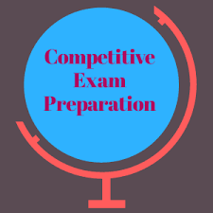
What is ?

Slide 3


Slide 4
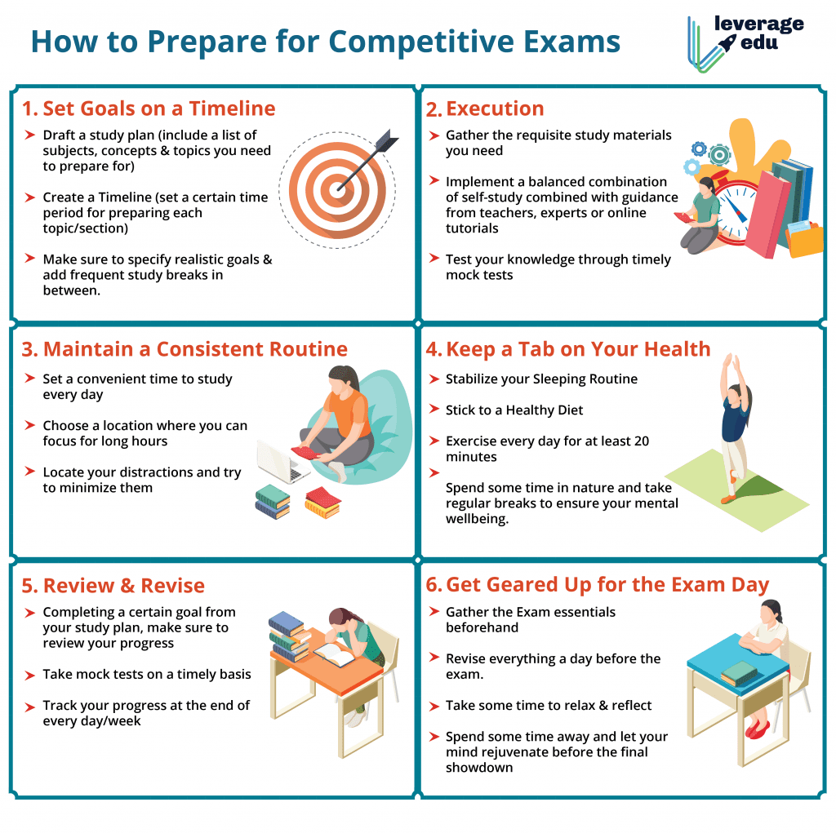

Slide 5
MY OPINION
HOW TO PREPARE COMPETITIVE EXAM
DECIDE YOUR GOAL
Plan Well. A well-laid plan means half of the job is done. .
Time Management. It is important to manage your time

Slide 6
wisely and smartly in order to achieve success.
Choose subjects wisely. ..
Shorter Study. ...
Mock Papers. ...
Motivation.

Slide 7


Slide 8
THANK YOU

